Slide 1
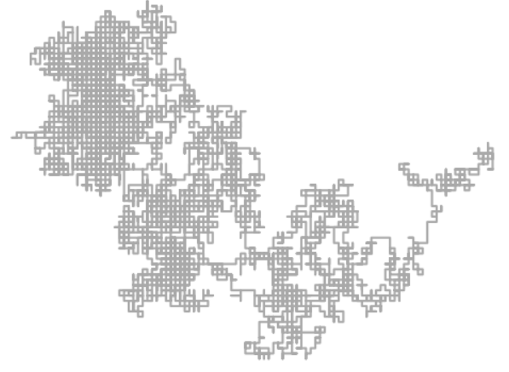
Brownian Motion:
From Finance to Pollock
A Two Dimensional Simulation Model

Slide 2
Table
What is Brownian Motion?
From Ancient Philosophers to Einstein.
How we simulated Brownian Motion?
A 4-Step Process!
Implications of Simulation
Predicting Stock Price Behaviour in Finance
Generating Drip Paintings?
Further Ideas
A Tool for River Cleanups

Slide 3
What is Brownian Motion?

Slide 4

A system of equations to simulate the random movements of a particle in a fluid
First described by the Roman philosopher Lucretius in 60 BC.
The idea was brought into discussion by botanist Robert Brown as he observed the behaviour of particles in a fluid. Decades later, Einstein formally represented the behaviours in thermodynamics. The equations he derived are represented below:
Source: http://stat.math.uregina.ca/~kozdron/Research/UgradTalks/BM_and_Heat/heat_and_BM.pdf
"...You will see a multitude of tiny particles mingling in a multitude of ways... that those bodies are in motion that we see in sunbeams, moved by blows that remain invisible." - Excerpt, "On the Nature of Things" (Lucretius, c. 60 BC)

Slide 5
How did we simulate Brownian Motion?

Slide 6
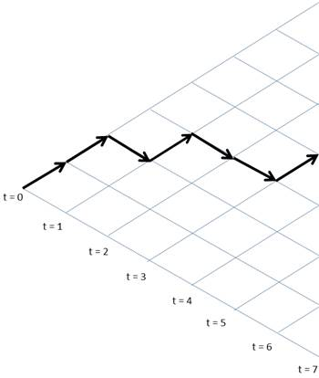
4 - Step Process:
Each step consists of choosing a value from 1 to 4.
Based on the random, the particle moves in 1 out of 4 directions (Up, Down, Left, Right).
Iterate each step thousands of times.
Plot!

Slide 7
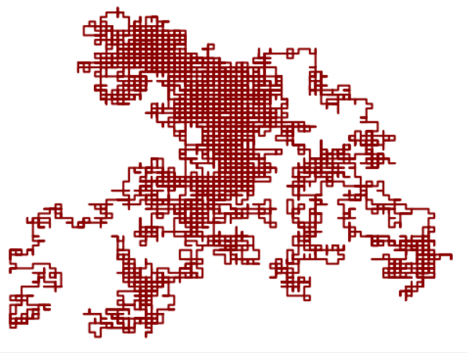
The Result:
A diagram of the path taken by a particle in a given fluid. In other words, we simulated Brownian Motion!
Notes:
Released in the early 30s by the Department of Agitation and Propaganda, this media text is intended for the proletarians of the USSR. The audience represents the illiterate and the poorest within the population. Regardless of age or gender, these people were peasants of mostly Caucasian descent and represented the majority of the former Russian Empire.

Slide 8
Applications of Simulation

Slide 9
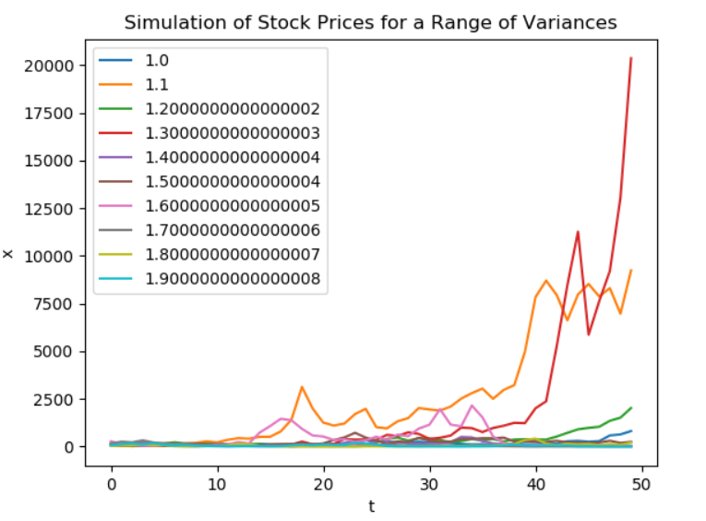

Finance
Brownian Motion is used to derive the behaviour of financial instruments. Most famously, the Black - Scholes equation.
They won the Nobel Prize in Economics for it!
Below is the Black-Scholes PDE for an European call/put option:
Source: http://www.iam.fmph.uniba.sk/institute/stehlikova/fd14en/lectures/05_black_scholes_1.pdf

Slide 10

Finance
For our simulation of the graph, we simulated multiple stock prices using the principles of geometric brownian motion.
Mathematically, it can be represented with the equation below:
Source: http://www.columbia.edu/~ks20/FE-Notes/4700-07-Notes-GBM.pdf

Slide 11
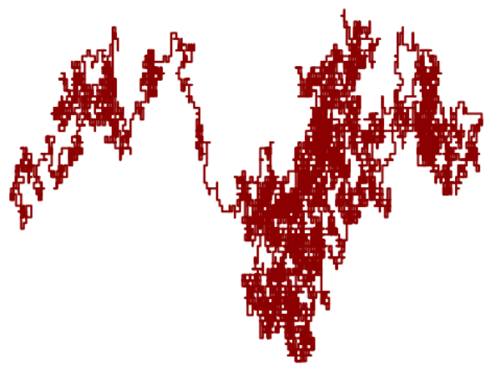
Art
We asked ourselves.
What if we simulated this once...

Slide 12
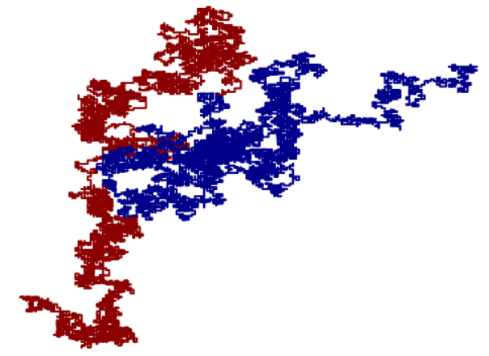
Art
We asked ourselves.
What if we simulated this once…
Twice! With a different colour...

Slide 13
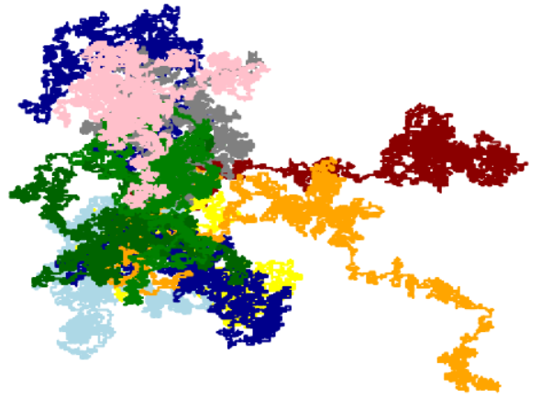
Art
We asked ourselves.
What if we simulated this once…
Twice! With a different colour…
Ten times with different colours….

Slide 14
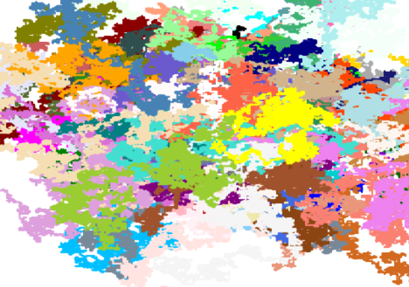
Art
We asked ourselves.
What if we simulated this once…
Twice! With a different colour…
Ten times with different colours….
Hundreds of times with different colours????

Slide 15
Art
We realized this.
We could make a drip-painting generator using a geometric brownian simulator!

Slide 16
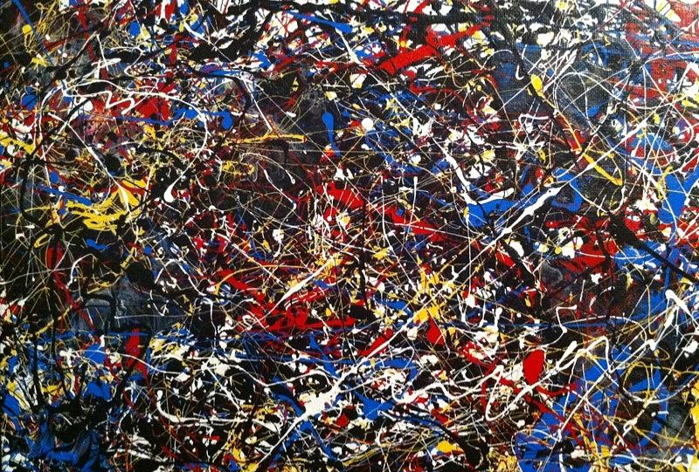
Art
Below is ‘Untitled 5’ by Jackson Pollock. Close enough!
https://fineartamerica.com/featured/untitled-5-jackson-pollock-inspired-vanessa-carpenter.html?product=art-print

Slide 17
Further Ideas

Slide 18
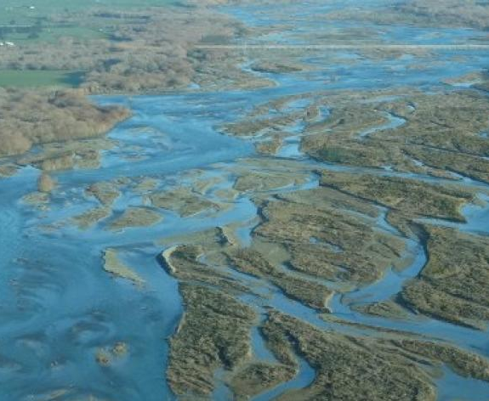
Tool for Cleaning River Deltas
Due to the coriolis effect, the rivers at the deltas tend to curve and stay to the shore.
Using Navier-Stokes equations, we can calculate the width and depth of this region depending on the flow rate of the river, its width and the coriolis force.
Using a more advanced simulation, we can verify the results from the Navier-Stokes equation.
https://www.odt.co.nz/news/election-2017/focus-swimmable-rivers-exporting-water

